Slide 1
Objects and Classes
BACS2023
Object-Oriented Programming
Chapter 4 – Part 3

Slide 2
Learning Outcomes (3)
At the end of this lesson, you should be able to:
Distinguish between object reference variables and primitive data type variables.
Describe garbage collection and the significance of the null value.
Use classes Date in the Java library.
Notes:
2

Slide 3
Default Constructors
All classes have constructors, whether you define it or not.
If no constructor is defined in the class, a default constructor is automatically provided as follows:
public Circle1(){ }
However, once you define your own constructor(s), the default constructor is no longer provided automatically.
Hence, if you still want a no-argument constructor, you have to define it yourself/explicitly.
Circle1.java

Slide 4
Default Value for Data Fields
Data Field Type | Default Value
Reference type | null
Numeric types | 0
Boolean | false
char | '\u0000'
public class Student {
String name;
int age;
boolean isScienceMajor;
char gender;
}
public class TestStudent {
public static void main(String[] args) {
Student student = new Student();
int count;
System.out.println("name? " + student.name);
System.out.println("age? " + student.age);
System.out.println("isScienceMajor? " + student.isScienceMajor);
System.out.println("gender? " + student.gender);
System.out.println(“count? ” + count);
}
}
Reminder:
No default values are assigned to local variables inside a method.

Slide 5
Data fields of reference types
E.g. in the Student class, the data field name is of the String type, a predefined Java class.
Default value for reference-typed data fields: null.

Slide 6
Example
Java assigns no default value to a local variable inside a method.
public class Test {
public static void main(String[] args) {
int x; // x has no default value
String y; // y has no default value
System.out.println("x is " + x);
System.out.println("y is " + y);
}
}
Compilation error: variables not initialized

Slide 7
Caution
NullPointerException is a common error.
It occurs when you invoke a method on a reference variable or data field with a null value.
public class TestStudent {
public static void main(String[] args) {
Student student;
System.out.println("name : " + student.name);
}
}

Slide 8
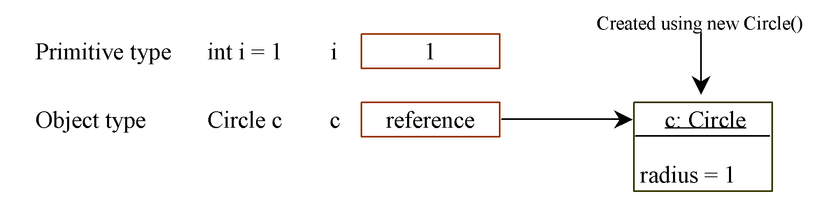
Differences between Variables of Primitive Data Types and Object Types
8

Slide 9

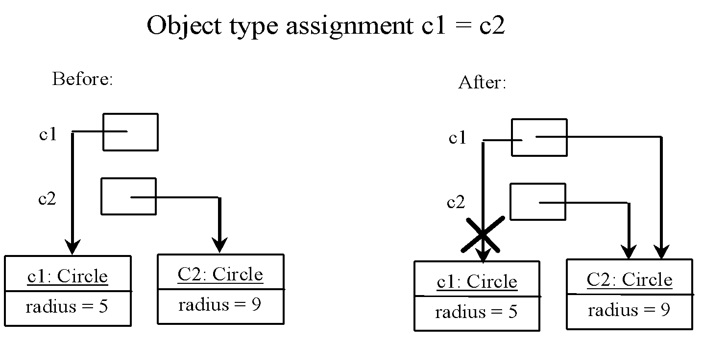
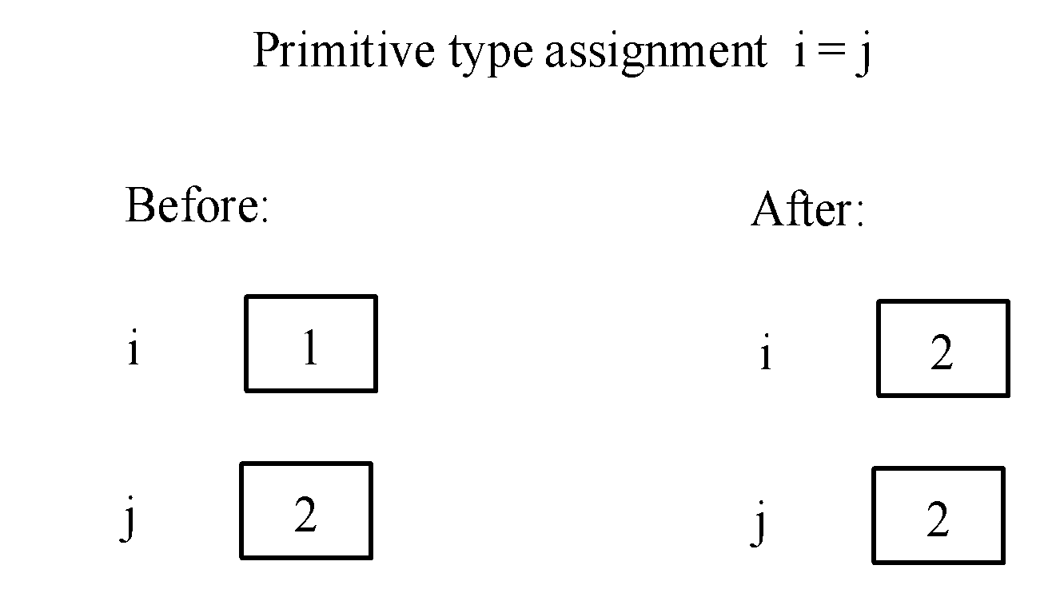
Copying Variables of Primitive Data Types and Object Types
The object previously referenced by c1 is no longer referenced. This object is known as garbage and it will automatically collected by JVM.
If you know that an object is no longer needed, you can explicitly assign null to a reference variable for the object.
https://www.techopedia.com/definition/27492/memory-allocation
https://www.scientecheasy.com/2020/06/memory-allocation-primitive-nonprimitive.html/

Slide 10
Using Classes from the Java Library
The Java library contains various classes that we can use to develop programs.
Examples of Java library classes:
Class | Example of methods
LocalDateTime | getYear()
Math | random()

Slide 11
The Date Class
Java does not have a built-in Date class, but you import the Date and Time API.
You can use the LocalDateTime class to create an instance for the current date and time and use its static method now() to obtains the current date-time from the system clock.
java.time.LocalDateTime
+ getYear(): int
+ getMonth: Month
+ getDayOfMonth(): int
+ now(): LocalDate
+ of(year:int, month:Month, dayOfMonth:int): LocalDate
+ toString():String
Return the year field
Return the month-of-year field
Return the day-of-month field
Return the current date-time from the system clock in the default time-zone
Return instance of LacalDateTime from year, month and day
Return datetime as a string

Slide 12
The Date Class Example
import java.time.LocalDate;
import java.time.Month;
public class DateTest {
public static void main(String[] args) {
LocalDate today = LocalDate.now();
LocalDate aprilFool = LocalDate.of(2024, Month.APRIL, 1);
System.out.println(“April fool : “ + aprilFool.toString());
System.out.println(“Today : “ + today.toString());
DateTimeFormatter format = DateTimeFormatter.ofPattern("dd-MM-yyyy");
String formatDateTime = today.format(format);
System.out.println("After Formatting: " + formatDateTime);
}
}
DateTest.java
Output:
April fool : 2024-04-01
Today : 2024-05-19
After Formatting: 19-05-2024

Slide 13
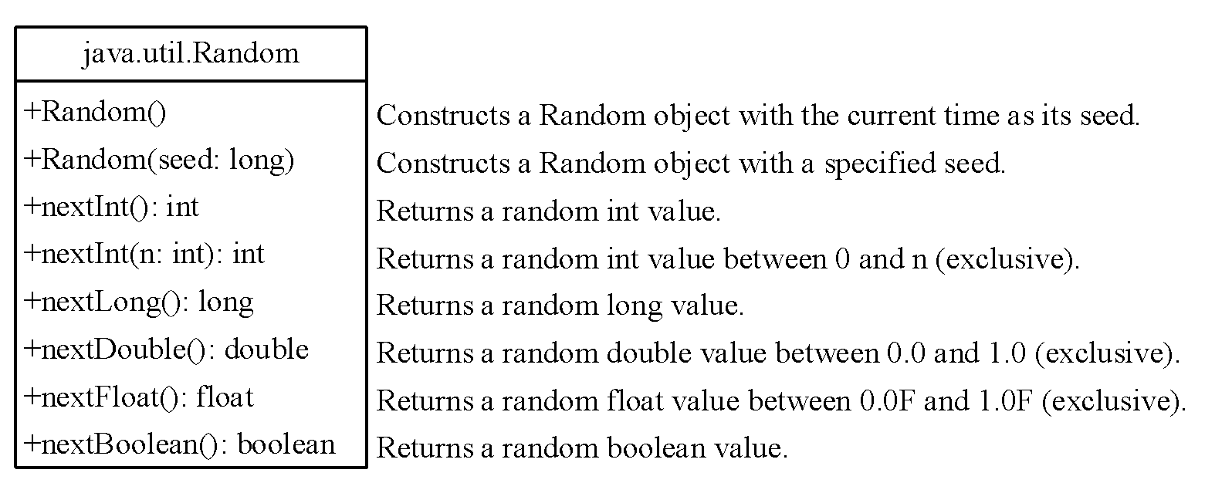
The Random Class
The Math.random() method returns a random double value between 0.0 and 1.0 (excluding 1.0).
The java.util.Random class provides more useful random number generators.

Slide 14
The Random Class Example
If two Random objects have the same seed, they will generate identical sequences of numbers. For example, the following code creates two Random objects with the same seed 3.
Random random1 = new Random(3);
System.out.print("From random1: ");
for (int i = 0; i < 10; i++)
System.out.print(random1.nextInt(1000) + " ");
Random random2 = new Random(3);
System.out.print("\nFrom random2: ");
for (int i = 0; i < 10; i++)
System.out.print(random2.nextInt(1000) + " ");.
TestRandom.java
From random1: 734 660 210 581 128 202 549 564 459 961
From random2: 734 660 210 581 128 202 549 564 459 961

Slide 15
Review of learning outcomes
You should now be able to
Distinguish between object reference variables and primitive data type variables.
Describe garbage collection and the significance of the null value.
Use classes Date in the Java library.
Notes:
15

Slide 16
Objects and Classes
BACS2023
Object-Oriented Programming
Chapter 4 – Part 4

Slide 17
Learning Outcomes (4)
At the end of this lesson, you should be able to
Distinguish between instance and static variables and methods.
Explain the use of visibility modifiers.
Declare private data fields with appropriate get and set methods.
Notes:
17

Slide 18

Instance Variables and Methods
Instance variables belong to a specific instance.
Instance methods are invoked by an instance of the class.
public class Circle {
private double radius; // The radius of the circle
private static int numberOfObjects; // no. of objects created
public Circle(double newRadius) {
radius = newRadius;
numberOfObjects++;
}
public static int getNumberOfObjects() {
return numberOfObjects;
}
public double getArea() {
return radius * radius * Math.PI;
}
}
18

Slide 19

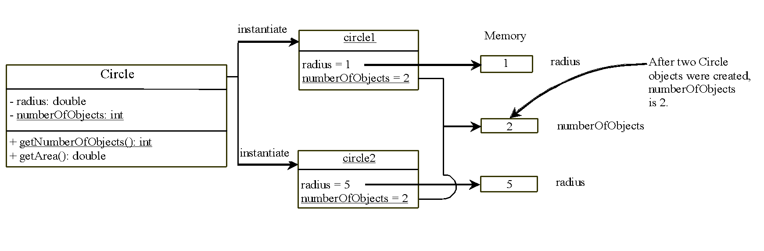
Static Variables, Constants and Methods(1)
Static variables
Are shared by all the instances of the class.
May be accessed using the object name or the class name.
The value for a static variable is stored in a common memory location.
All objects will be affected if one of them changes the value of the static variable.
UML Notation:
- : private variable or methods
+: public variables or methods
underline: static variables or methods

Slide 20
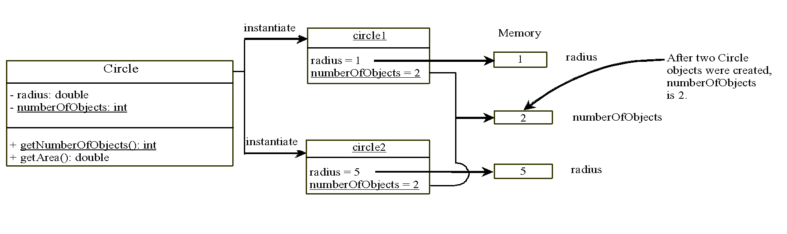
Static Variables, Constants and Methods(2)
Static methods are not tied to a specific object.
Static constants are final variables shared by all the instances of the class.
To declare static variables, constants and methods, use the static modifier.
UML Notation:
- : private variable or methods
+: public variables or methods
underline: static variables or methods
radius is an instance variable.
numberOfObjects is a static variable.
getNumberOfObjects() is a static method.
getArea() is an instance method.

Slide 21
A Simple Circle Class
class Circle {
private double radius;
private static int numberOfObjects;
public Circle(double radius) {
this.radius = radius;
numberOfObjects++;
}
public static int getNoOfObjects() {
return numberOfObjects;
}
public double findArea() {
return Math.PI * radius * radius;
}
}
public class TestCircle {
public static void main(String[] args) {
Circle circle1 = new Circle(5);
Circle circle2 = new Circle(17);
System.out.println(“Area : ” + circle1.findArea());
System.out.println(“No. of objects = " +
circle1.getNoOfObjects());
System.out.println(“Area = " + circle2.findArea());
System.out.println(“No. of objects = " +
circle2.getNoOfObjects());
System.out.println("Circle.getNoOfObjects() = " +
Circle.getNoOfObjects());
}
}
TestCircle.java

Slide 22
instance methods VS static methods
import java.util.Scanner;
Scanner scan = new Scanner(System.in);
System.out.print(“Enter a number: ”);
int number = scan.nextInt();
import javax.swing.JOptionPane;
String numString =
JOptionPane.showInputDialog(“Enter a number: ”);
int number = Integer.parseInt(numString);
public class Vehicle {
private String plateNo;
private int passengers;
private int fuelCap;
private int mpg;
public int range() {
return fuelCap * mpg;
}
public String toString(){
return “Plate No : ” + plateNo + …
“Range : ” + range();
}
}
public class TestMethod {
public static void main(String[] args) {
System.out.println("" + max(5,7));
}
public static int max(int num1, int num2){
……………...........................
}
public class TestMethodFromOtherClass {
public static void main(String[] args) {
System.out.println("" + TestMethod.max(5,7));
System.out.println("" + Math.max(5,7));
}
}
public class TestVehicle {
public static void main(String[] args) {
Vehicle car = new Vehicle();
System.out.println("" + car.range());
}
}

Slide 23
Caution:
Static variables and methods can be used from instance or static methods in the class.
Instance variable and methods can only be used from instance methods, not from static methods.
public class Foo{
int i = 5;
static int k = 2;
public static void main(String [] args) {
int j = i;
m1();
}
public void m1() {
i = i + k + m2(i, k);
}
public static int m2(int i, int j){
return (int)(Math.pow(i,j));
}
}
Foo.java

Slide 24
Professional Programming Tip
To improve readability
Use ClassName.staticVariable to access a static variable
Use ClassName.staticMethodName() to invoke a static method

Slide 25
Learning Outcomes (5)
At the end of this lesson, you should be able to
Distinguish between instance and static variables and methods.
Explain the use of visibility modifiers.
Declare private data fields with appropriate get and set methods.
Notes:
25

Slide 26
Visibility Modifiers (1)
class Vehicle {
String plateNo;
int passengers;
int fuelCap;
int mpg;
int range() {
return fuelCap * mpg;
}
}
public class VehicleDemo {
public … main(Sting args [ ]) {
Vehicle car = new Vehicle();
car. plateNo = “WWW 1234”;
car. Passengers = 4;
car. fuelCap = 20;
car. mpg = 10;
……….
}
}
Restricting access to a class’ members is a fundamental part of OOP because it helps prevent misuse of an object.
Member access control is achieved through the use of 4 visibility modifiers:
default
By default, the class, variable or method can be accessed by any class in the same package (folder).
public
The class, data, or method is visible to any class in any package.
private
The data or methods can be accessed only by the declaring class.
protected
(Will be covered in a future chapter).

Slide 27
Visibility Modifiers (2)
class Circle {
private double radius; // declare radius data as private
public Circle() // default constructor
{ radius = 1.0; }
public void setRadius( double r)
{ radius = r; }
public double findArea()
{ return Math.PI * radius * radius; }
} // end Circle Class
public class TestModifier {
public static void main(String [] args) {
Circle c1 = new Circle();
c1.radius = 5.2; // Invalid statement: access violation
c1.setRadius(5.2);
System.out.println(“Area for c1 = ” + c1.findArea());
}
}

Slide 28
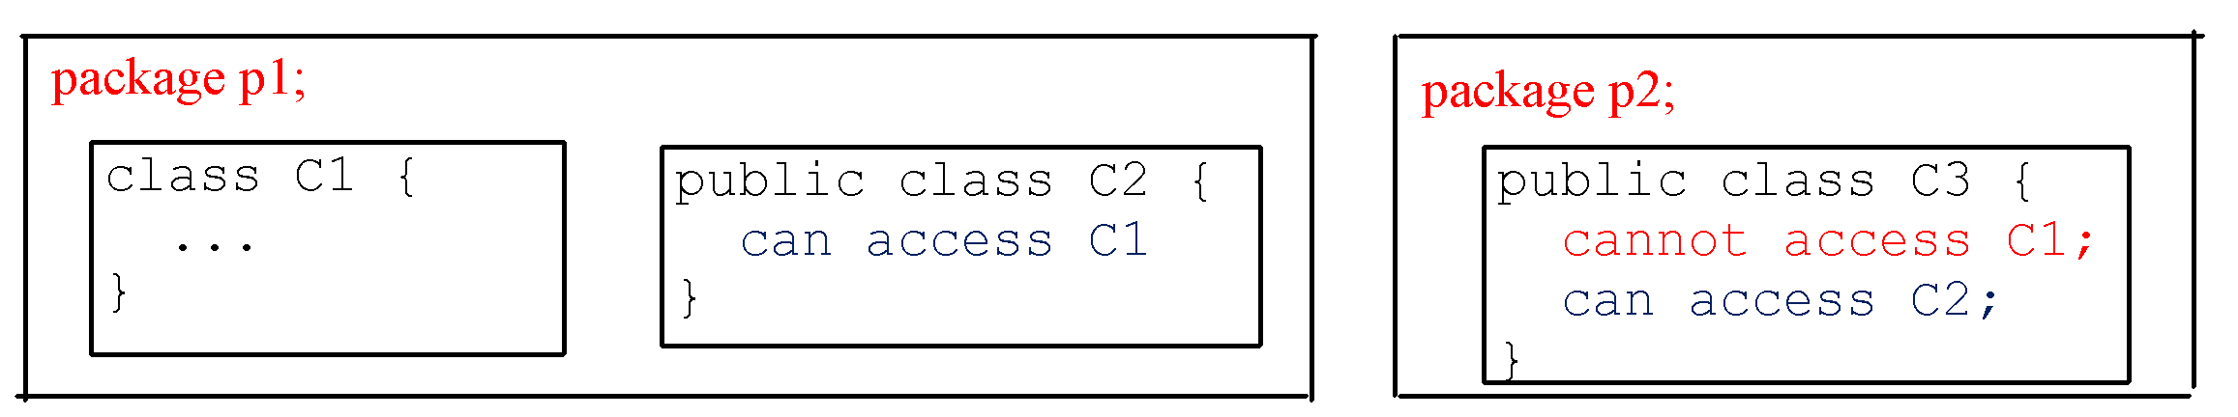
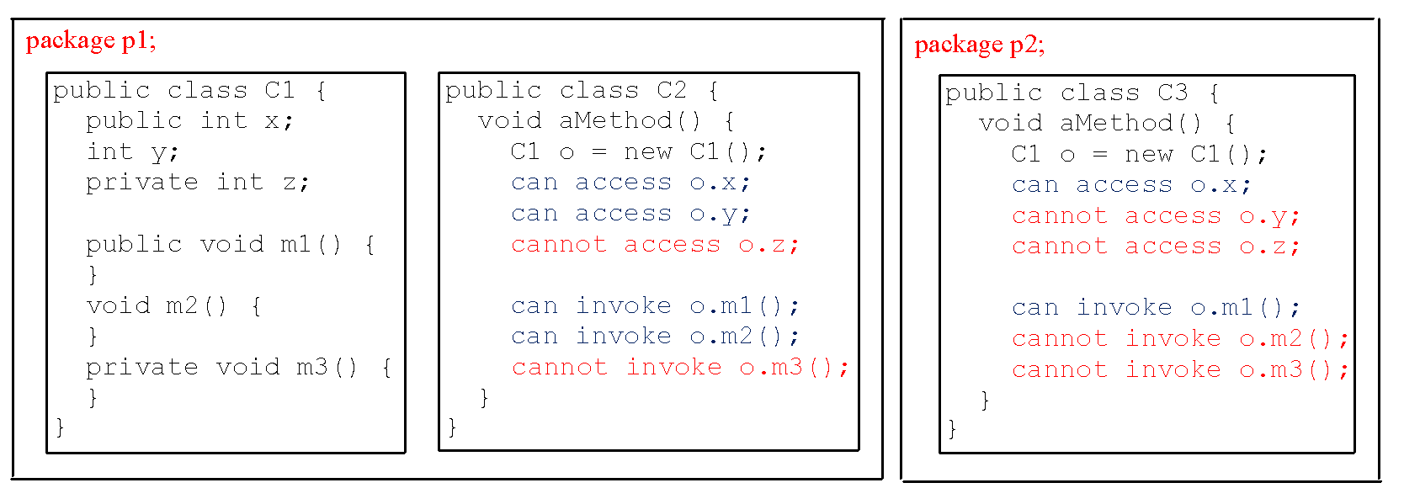
The private modifier restricts access to within a class.
The default modifier restricts access to within a package.
The public modifier enables unrestricted access.

Slide 29
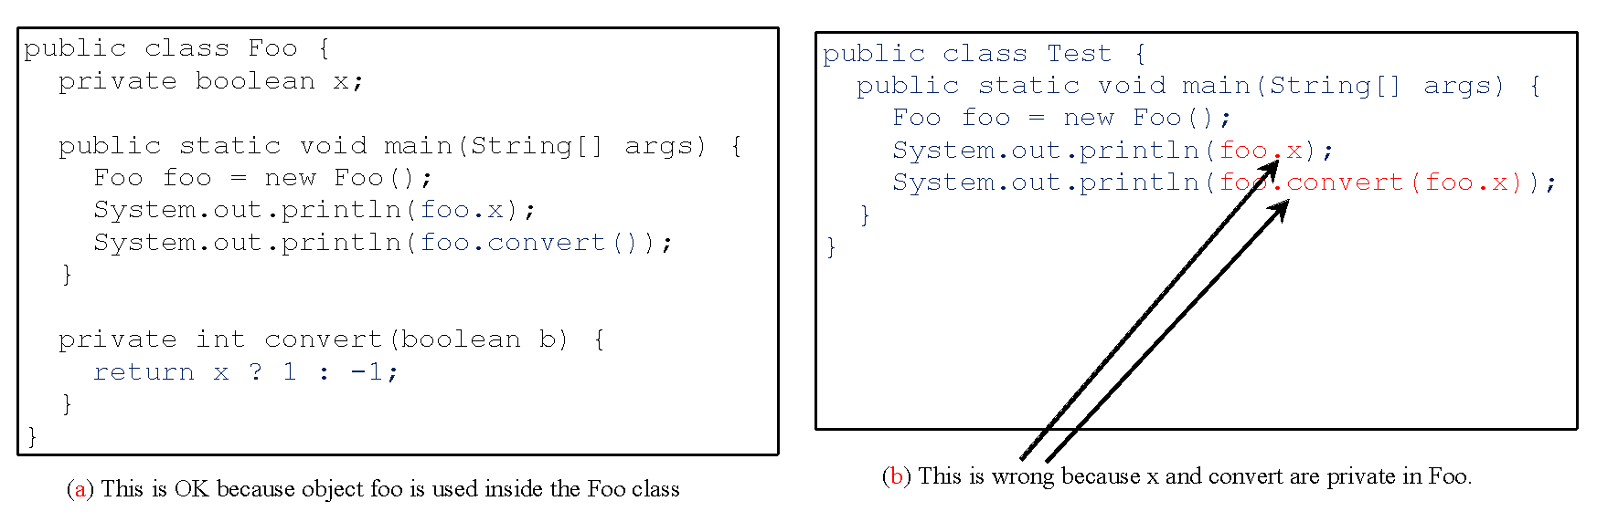
NOTE
An object cannot access its private members, as shown in (b). It is OK, however, if the object is declared in its own class, as shown in (a).

Slide 30
Why Data Fields Should Be private?
It is not good for the data members of one class to be able to modified directly from another class because:
Data may be tampered.
It makes the class difficult to maintain and vulnerable to bugs.
To protect data fields from direct modification and to make the class easy to maintain, declare the data fields as private.
A private data field cannot be accessed by an object through a direct reference outside the class.
How then can a client retrieve and modify a data field?
By providing accessor and mutator methods.

Slide 31
Mutators
and
Accessors
// file Name : Circle2Demo.java
class Circle2 {
private double radius; // declare radius data as private
Circle2() // default constructor
{ radius = 1.0; }
public void setRadius( double r)
{ radius = r; }
public double getRadius()
{ return radius;}
public double findArea()
{ return Math.PI * radius * radius; }
} // end Circle2 Class
public class Circle2Demo {
public static void main(String [] args) {
Circle2 C1 = new Circle2();
// C1.radius = 5.2;
C1.setRadius(5.2);
System.out.println(“Radius of c1 = ” + c1.radius); ? ?
System.out.println(“Area for C1 = ” + C1.findArea());
}
}
define public method called setRadius() to be called by other class.
Invalid statement: Access violation

Slide 32
Accessor/Mutator Methods
Accessor methods
Methods used to read private properties.
a.k.a. getter or get methods
Has the following method signature:
public returnType getPropertyName()
Mutator methods
Methods used to modify private properties.
a.k.a. setter or set methods
Has the following method signature:
public void setPropertyName(datatype propertyValue)

Slide 33
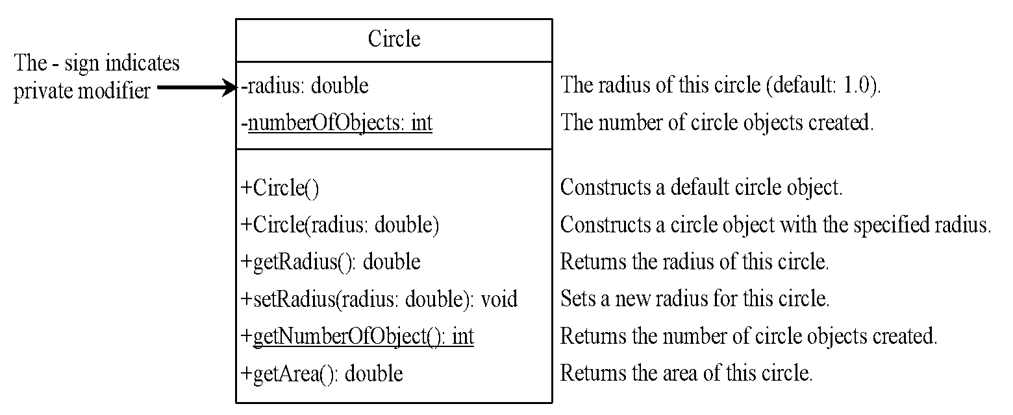
Example of Data Field Encapsulation
TestCircle3.java

Slide 34
public class Student {
private String id;
private int creditHours;
private int pointEarned;
private double gpa;
public Student(String d,int c,int p) {
id = d;
creditHours = c;
pointEarned = p;
}
public void setCreditHour(int c)
{ creditHours = c; }
public void setPointEarned(int p)
{ pointEarned = p; }
public String getId()
{ return id; }
public int getPointEarned()
{ return pointEarned; }
public int getGpa()
{ return gpa; }
public void computeGPA()
{ gpa = (double)pointEarned / creditHours;}
}
public class TestStudent {
public static void main(String[] args) {
Student s = new Student(“111”,30, 90);
s.computeGPA();
System.out.println(s.getId()+ “scored ”
+ s.getGpa();
}
}

Slide 35
UML Diagram access modifiers
Circle
-radius: double
+Circle() +Circle(radius: int) +Circle(radius: double) +getRadius(): double +setRadius(radius: double): void +getArea(): double

Slide 36
Review of learning outcomes
You should now be able to
Distinguish between instance and static variables and methods.
Explain the use of visibility modifiers.
Declare private data fields with appropriate get and set methods.
Notes:
36

Slide 37
To Do
Review the slides and source code for this chapter.
Read up the relevant portions of the recommended text
Do the tutorial and complete the remaining practical questions for this chapter.
We shall selectively discuss them during class.

